Slide 1


BCSE0004: Operating Systems
Process Creation, Suspension & Termination in Operating Systems

Slide 2
Agenda
Process Creation
Process Suspension
Process Termination

Slide 3
Process Creation
When a new process is created, operating system assigns a unique Process Identifier (PID) to it and inserts a new entry in primary process table.

Slide 4
Contd…
Some of the events that lead to process creation are as follows:
User request for process creation
System Initialization
Execution of a process creation system call by a running process

Slide 5
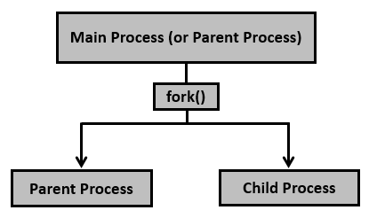
Contd…

Slide 6
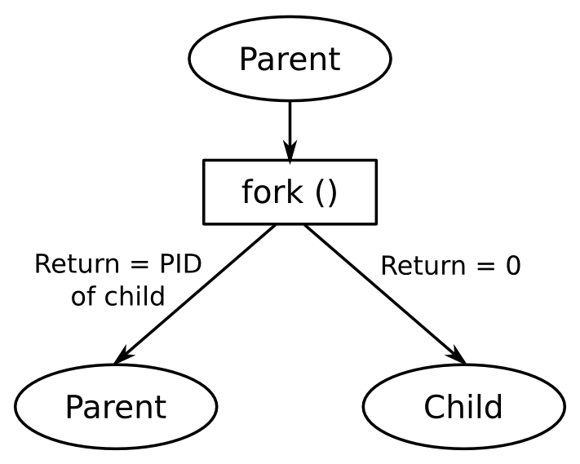
Contd…

Slide 7
Process Suspension
Process suspension and resumption are used to temporarily stop a process from executing and then restart it again.

Slide 8
Contd…
Swapping is an I/O operation. It enhances performance. When all the processes in main memory are in the Blocked state, the operating system can suspended one process by putting it in the Suspended state and transferring it to disk.
The space that is freed up in the memory can then be used to bring in another process.

Slide 9
Process Termination
Process termination occurs when the process is terminated.
The exit() system call is used by most operating systems for process termination.

Slide 10
Contd…
Some of the causes of process termination are as follows:
A process may be terminated after its execution is naturally completed.
A child process may be terminated if its parent process requests for its termination.
A process can be terminated if it tries to use a resource that it is not allowed to.
If an I/O failure occurs for a process, it can be terminated.

Slide 11
New
Ready
Waiting
Executing
Blocked
Suspended
Terminated

Slide 12


